Slide 1
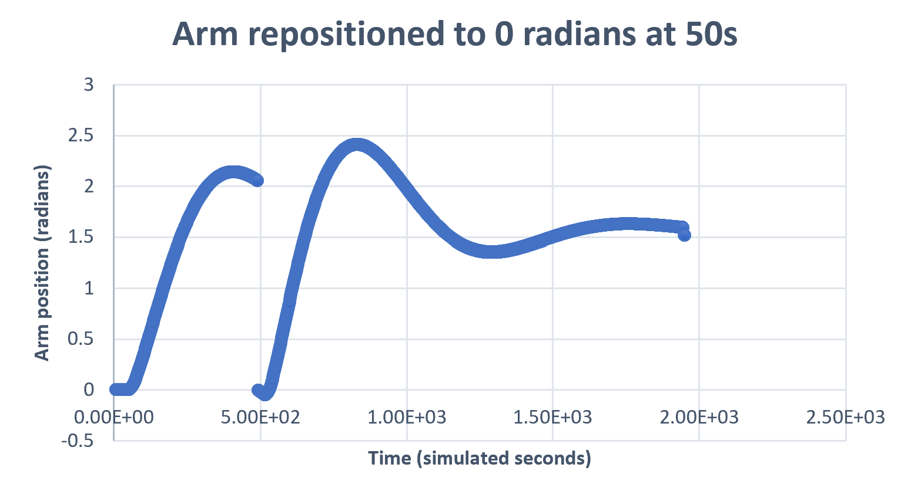
<AlterTargetAngle>
<RepositionArm>

Slide 2
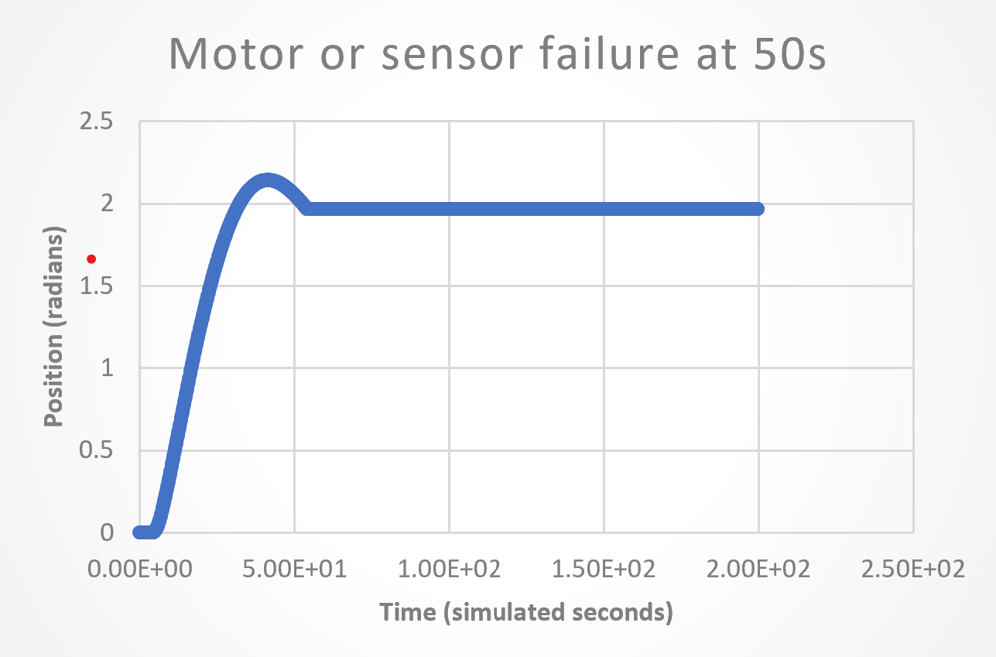
<MotorFail> / <SensorFail>

Slide 3
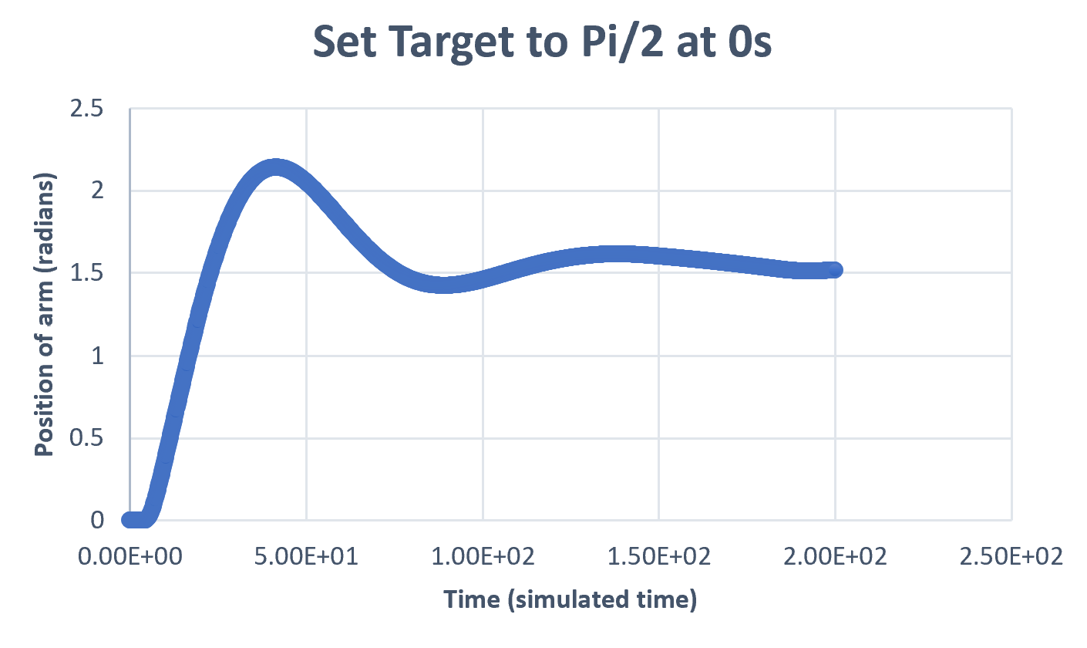
Alter target at 1s
<AlterTargetAngle>

Slide 4
Alter target at 10s and 60s
<AlterTargetAngle>
<AlterTargetAngle>

Slide 5
<AlterTargetAngle>
<ShutdownController>

